Slide 1
OSM 419 – Operations Strategy
Asset Location, Global Networks, and Offshoring

Slide 2
Globalization
Processes leading to increased interaction among different world regions
What does this have to do with operations?
  Facilities and markets are international
  Globalization provides flexibility
  Operations as part of a network

Slide 3
Why firms globalize their operations?
Supply factors behind globalization
Technological factors behind globalization
Market demand factors behind globalization
Macroeconomic and non-market factors behind globalization

Slide 4
Globalization and Supply
Direct costs: locate close to suppliers
  Paper plants, steel mills
  Labor costs
Capital costs: Joint ventures enable sharing of costs and risks
Taxes: government incentives

Slide 5
Globalization and Technology
Access to knowledge and skills
Swiss watch makers
ShengZhou: “tie city” of China
High-precision tools from Japan and Germany
Software engineering in India
Importance of improving infrastructure: communications, transportation

Slide 6
Globalization and Markets
Improve market access and increase revenues
Local presence, content and service considerations
“Local presence”: foreign auto makers in United States
Importance of population size and growth
Population density
Purchasing power
Starbucks example

Slide 7
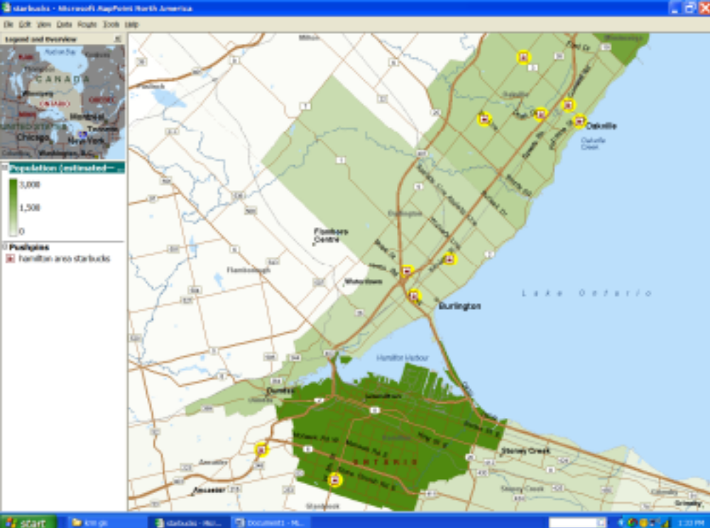
Starbucks locations
Population density per square kilometer for each census subdivision.
7/38

Slide 8
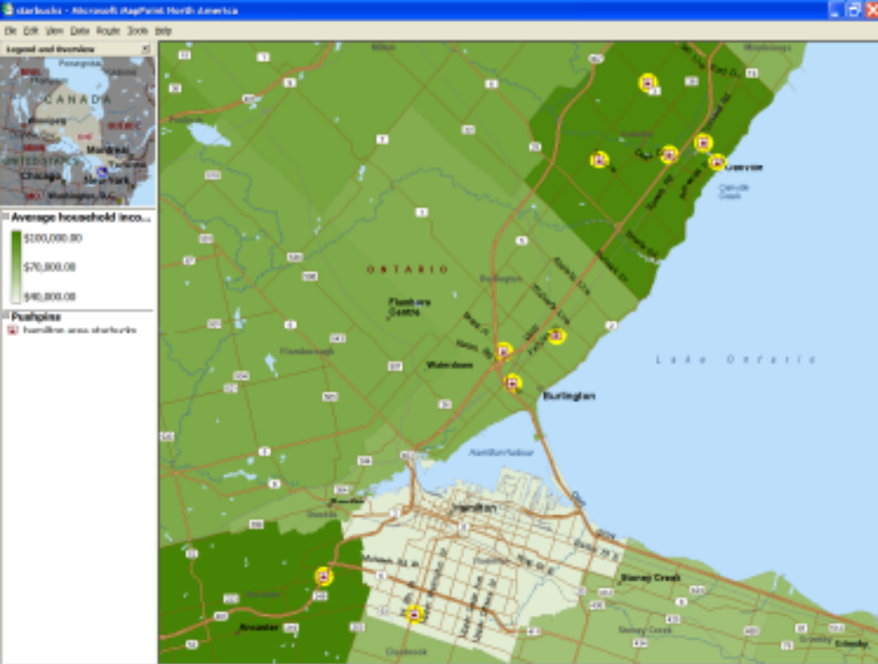
Per Capita Household Income Map
8/38

Slide 9
Globalization, Macroeconomic Non-market Factors
Currency fluctuations
Political (in)stability
Tariffs and quotas
  Toyota in the US
  Harley-Davidson in Brazil
Regulation
Treaties and free trade zones attempt to mitigate some of these risks

Slide 10
Location decision examples
Silicon Valley
Harley-Davidson
  Used specialized consulting company
  Supply issues, including labor
  Quality of life (education, religion, etc.)
  Airport

Slide 11
Strategic Framework for Location Decisions
Hierarchical location framework
1) Strategic role of location
2) Global assessment
3) Country segmentation
Total landed cost
Strategic fit
Update model dynamically

Slide 12
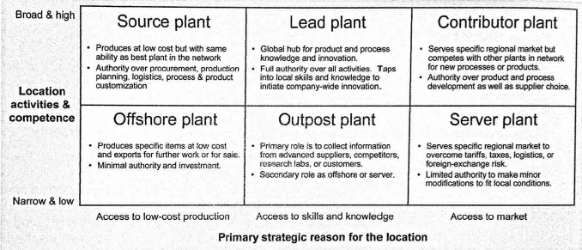
Strategic Role of Location
1) What is the primary strategic reason for the facility’s location?
2) What is the scope of its current activities and competencies?

Slide 13
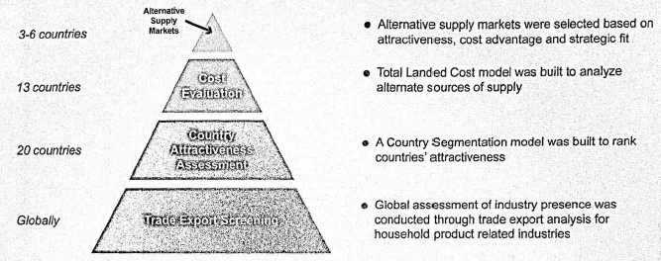
Global Assessment

Slide 14
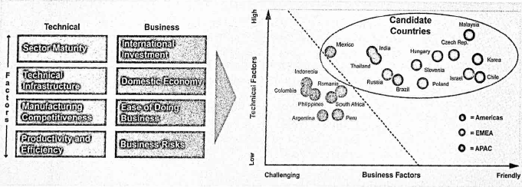
Country Segmentation: Rank attractiveness

Slide 15
Total Landed Cost Calculations
TLC = total end-to-end cost to transform inputs at sourcing location to outputs at customer locations
Track flow units along their routes
Record costs that are incurred along the way

Slide 16
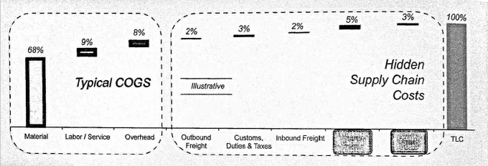

Total Landed Cost
Cost components in TLC: COGS and Logistics

Slide 17
Example: network with offshore plant and domestic distribution center (DC)
  Costs of inbound raw materials and services purchased at offshore plant
  Inbound logistics: costs of moving inputs to offshore plant
  Processing and inventory costs at offshore plant
  Overhead at offshore and domestic plant
  Logistics from offshore plant to domestic DC: consider cost and lead times for
    Offshore plant > offshore port > domestic port > DC
    Consider working capital (both cash cost and pipeline inventory)
  Outbound fulfillment from DC
    Consider safety stock and outbound transportation
  Include any other costs that are incurred (travel, translation, etc.)

Slide 18
Total Landed Cost
Cost components in TLC: StartUp, Learning Curve and Quality Control
Cost components in TLC: Service Levels, Lead-times, and Inventory Holding Costs
  Pipeline inventory
  I_{in-transit} = throughput X transportation lead-time
  Longer lead-times and higher service levels increase the safety stock
Quantifying service – Location Tradeoffs
Dynamic Updating of TLC and Strategic Location with Operations Strategy

Slide 19
Types of Inventory
Three aggregate categories
  Raw materials
  Work-in-process
  Finished goods
Classified by how it is created
  Cycle inventory
  Safety stock inventory
  Anticipation inventory
  Pipeline inventory

Slide 20
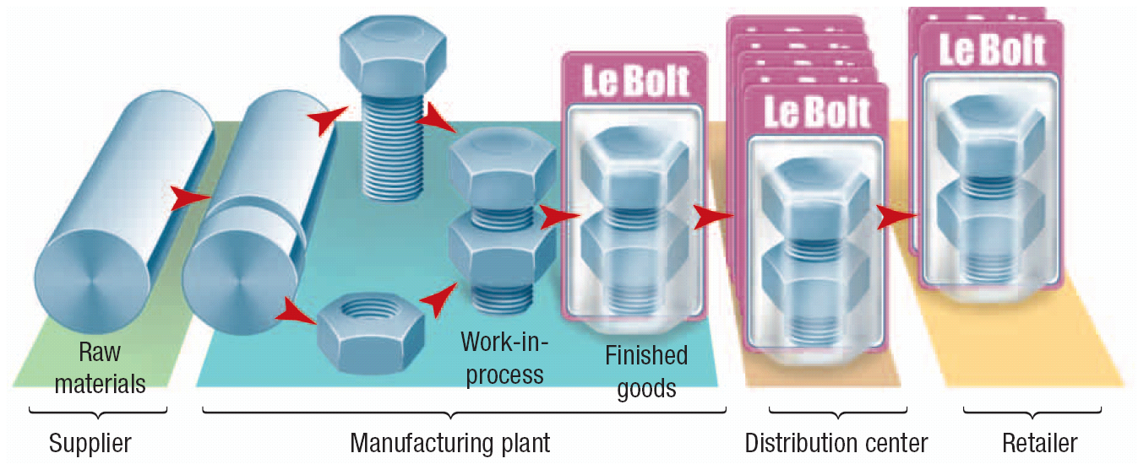
Types of Inventory
Inventory at Successive Stocking Points

Slide 21
Cycle Inventory
Lot sizing principles
  The lot size, Q, varies directly with the elapsed time (or cycle) between orders.
  The longer the time between orders for a given item, the greater the cycle inventory must be.
Q + 0
2
Q
2
Average cycle inventory = =

Slide 22
Pipeline Inventory
Pipeline inventory
Average demand during lead time = D_{L}
Average demand per period = d
Number of periods in the item’s lead time = L
Pipeline inventory = D_{L} = dL

Slide 23
Estimating Inventory Levels
EXAMPLE
A plant makes monthly shipments of electric drills to a wholesaler in average lot sizes of 280 drills. The wholesaler’s average demand is 70 drills a week, and the lead time from the plant is 3 weeks. The wholesaler must pay for the inventory from the moment the plant makes a shipment. If the wholesaler is willing to increase its purchase quantity to 350 units, the plant will give priority to the wholesaler and guarantee a lead time of only 2 weeks. What is the effect on the wholesaler’s cycle and pipeline inventories?

Slide 24
Estimating Inventory Levels
SOLUTION
The wholesaler’s current cycle and pipeline inventories are
Q
2
Cycle inventory = =
140 drills
Pipeline inventory = D_{L} = dL =
(70 drills/week)(3 weeks)
= 210 drills

Slide 25
Estimating Inventory Levels
1. Given the average lot size, average demand during a period, and the number of periods of lead time:
Average lot size
Average demand
Lead time
350
70
2
2. To compute cycle inventory, simply divide average lot size by 2. To compute pipeline inventory, multiply average demand by lead time
Cycle inventory
Pipeline inventory
175
140

Slide 26
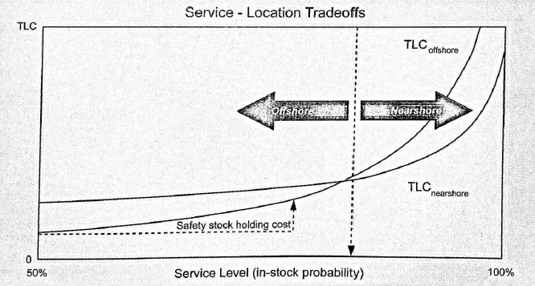
Service-Location Tradeoff

Slide 27
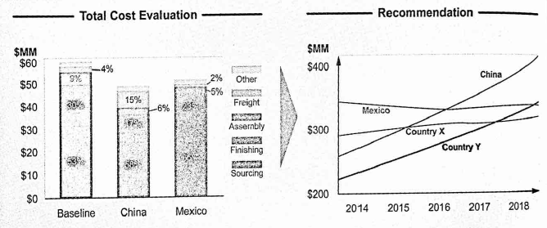
TLC evaluation and
Dynamic Updating

Slide 28
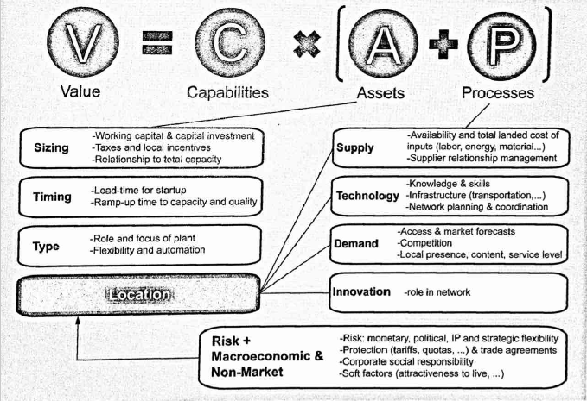
Checklist of factors in location decisions

Slide 29
Location Decisions in Practice
Belgian patisserie – Poppies International
Proximity to a major airport
The need for a large daily supply of eggs and fresh cream
Utility costs
Use spreadsheet analysis to estimate TLC
Use a weighted average approach to incorporate multiple factors in location decision
Use a regression based approach

Slide 30
Geographical - Spatial Location Analysis
Quantifies supply and demand
Used when transportation cost is important
Considers infrastructure
Supply chain cost analysis
Customer density analysis
Comparison of Total Landed Costs

Slide 31
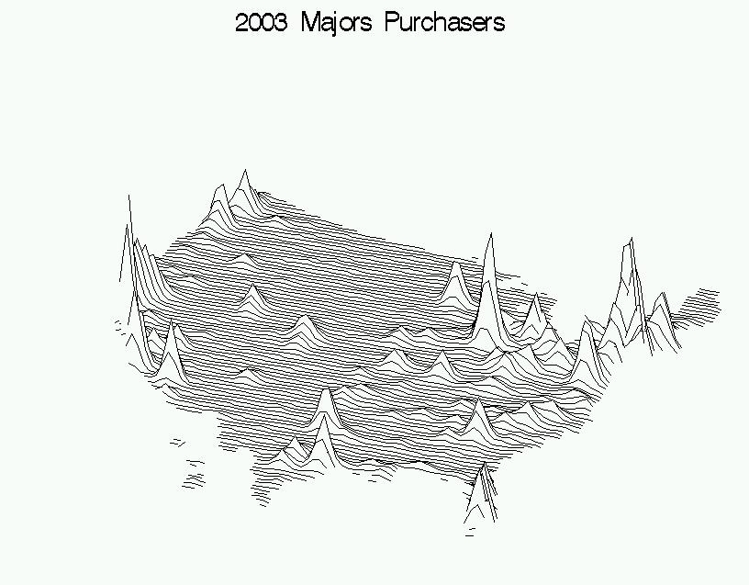
Capacity Location: Spatial analysis:
US product distribution for a major appliance manufacturer: Customer Density
Notes:
OPNS454 Week 4: Capacity Timing and Location
10/10/2018
© Van Mieghem
31

Slide 32
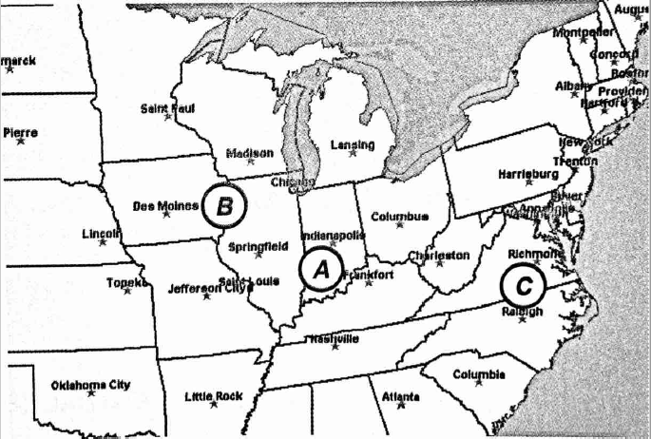
Network Analysis
Locations and connections are considered as a system
Sizing and timing are related
Future expansion should be considered as well

Slide 33
Centralization vs. Distribution
Interaction between capacity size and location
Centralization: “bigger is better”
Distribution: “closer is better”

Slide 34
Benefits of Centralization
Centralize to allow resource sharing
Financial benefits from economies of scale and risk pooling
Often better for ensuring consistent quality
Example: Airline hub-and-spoke networks

Slide 35
Benefits of Distribution
Retail facilities: customers visit nearby locations
Delivery services
Customer convenience
  Banking
  Emergency services
Local presence

Slide 36
Outbound Transportation Economics
What does it cost to ship from central location to distributed customer base?
Costs increase in scale as the distance increases
Trade-off: costs of transportation vs. costs of inventory and capacity

Slide 37
Capacity analysis: Should a network be centralized or distributed?
Cost
per unit
Costs with decreasing
returns to scale (transportation)
Total cost (sum)
Costs with increasing returns
to scale (capacity, inventory)
Size of area served
by one location
0
0
Economically optimal
size of area served
from one location
Distributed network
Centralized network
Capacity sizing and location are interdependent!
Notes:
OPNS454 Week 4: Capacity Timing and Location
10/10/2018
© Van Mieghem
37

Slide 38
Localization vs. Standardization
Should resources and processes be the same at each location?
Or should they reflect characteristics of the local environment?

Slide 39
Benefits of Standardization
Economies of scale in development and implementation of production and service facilities
Economies of scale in equipment purchasing and other sourcing
The capacity of standardized facilities is pooled, so demand can be shifted among them

Slide 40
Standardization Example:
Intel’s “Copy Exactly”
Everything is duplicated for each new plant
This includes process flow, equipment, suppliers, layout, training
For high-volume factories, this enables fast implementation and increased revenues

Slide 41
Benefits of Localization
Customer preferences and regulations may require customization
Supply chain requirements and opportunities may be different
Localization may lead to innovations that improve the whole system

Slide 42
When to produce locally in a global network
Substantial local market
Speed as competitive strategy
Transportation and tariff costs are high
High risk of currency exchange fluctuations
Demand with high volatility and large price differences

Slide 43
Global Network Choices:
Integrate of Separate
Network integration: choosing the number and type of possible allocations from resources to markets, which affect network flexibility
Separate networks
Integrated networks and network flexibility

Slide 44
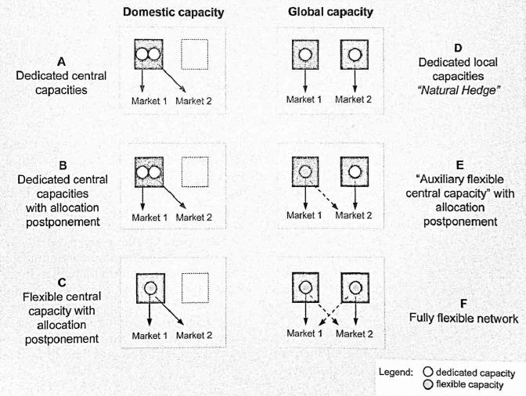
Global Network Choices:
Integrate of Separate

Slide 45
Location, Flexibility and Lead-times
Lead-time consists of production time plus transportation time
Short transportation times (local capacity) allow for postponement of production
If production lead-times are also short (flexible capacity), production can be further postponed
Both types of postponement enable better matching of supply and demand

Slide 46
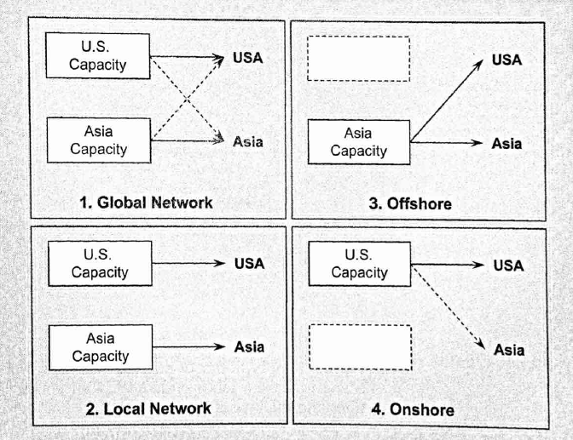
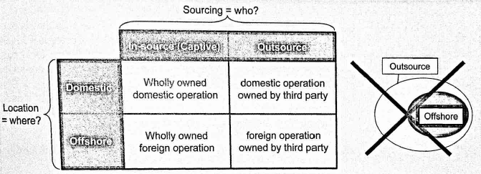
Offshoring and outsourcing
Outsourcing: supply by external party
Offshoring: locating operations abroad
Distinguish between
  Where an operation is performed
  Who owns the operation

Slide 47
Offshoring Benefits
Cost reduction
  Labor
  Direct costs of materials
Market opportunities
Lead-time reduction
  Cheaper labor allows for more safety capacity
  Time-to-market: cheaper and faster failures allow more chances to succeed

Slide 48
Offshoring Risks
Competition: low-cost strategy is easy to copy
Currency fluctuations
Political instability or uncertainty
Risk to intellectual property
Health, environment, corporate social responsibility

Slide 49
Operational Risks of Offshoring
Additional costs
  Tariffs, import taxes
  Longer supply chains
  Quality risks
Longer and more variable lead-times
  Reduced market responsiveness
  Increased safety inventories
  Need for domestic backup source
Service risk: culture and language

Slide 50
General Rationale for Offshoring
Pro
Con
Cost reductions
Proximity to local or new markets
Domestic labor market constraints
Operational hedge
Foreign trade barriers
Transportation costs
Lead times
Risks
  Quality, including health, environmental and CSR
  Currency, IP, political, competitive
Domestic trade barriers
Global operations’ complexity and social implications
Notes:
OPNS454 Week 4: Capacity Timing and Location
10/10/2018
© Van Mieghem
50

Slide 51
Survey: Reasons for Offshoring
Cost reduction
97%
Growth strategy
73%
Competitive pressure
71%
Access to qualified personnel
70%
Industry practice
52%
Improved levels of service
50%
Business process redesign
48%
Changing the rules of the game
37%
Increased speed to market
35%
System redundancy
33%
Access to new markets
25%
The percentage of 2006 survey participants that cite the goals listed as a reason for offshoring.

Slide 52
Summary and connections…
Integrate location with other aspects of operations strategy
Use location analysis to quantify measures
Consider costs and revenues
Flexibility is valuable in global networks
Strategies should be tailored to product, industry and market characteristics

